Slide 1
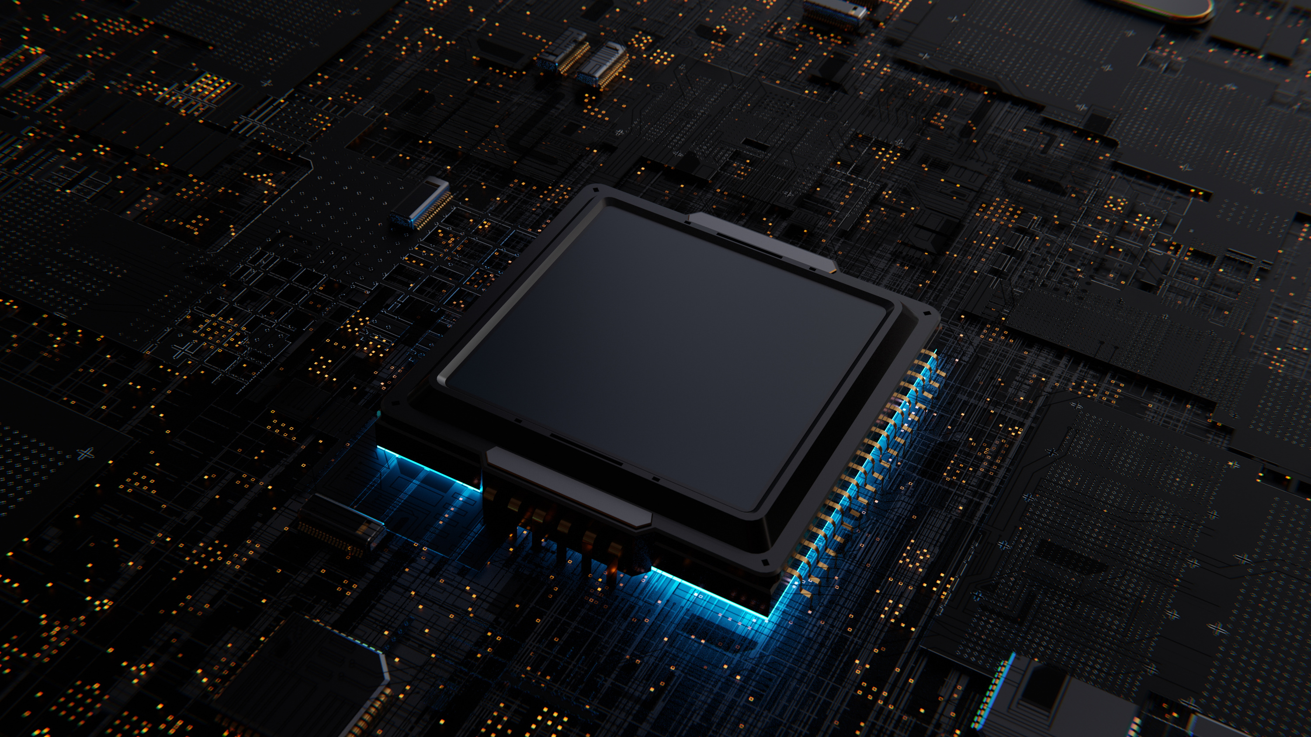

Slide 01
HUMAN STRESS DETECTION AND PREDECTION USING ANN

Slide 2


Introduction
Welcome to Stress Detector—your AI-driven tool for detecting and predicting stress levels.
Leveraging advanced Artificial Neural Networks (ANN), our platform analyzes physiological data to identify patterns associated with stress.
With a user-friendly interface and real-time insights, Stress Detector empowers users to understand and manage their mental well-being proactively.

Slide 3


DATA PARAMETERS
Snoring Rate
Respiratory Rate
Body Temperature
Limb Movement
Blood Oxygen
Eye Movement
Sleep Hours
Heart Rate
Stress Level

Slide 4
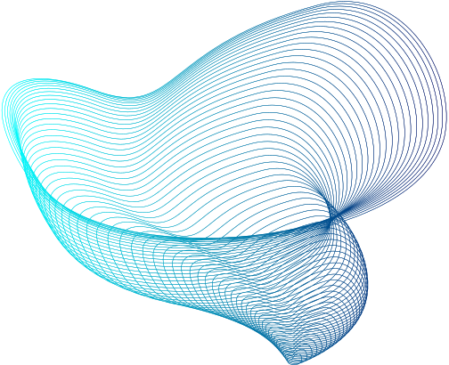

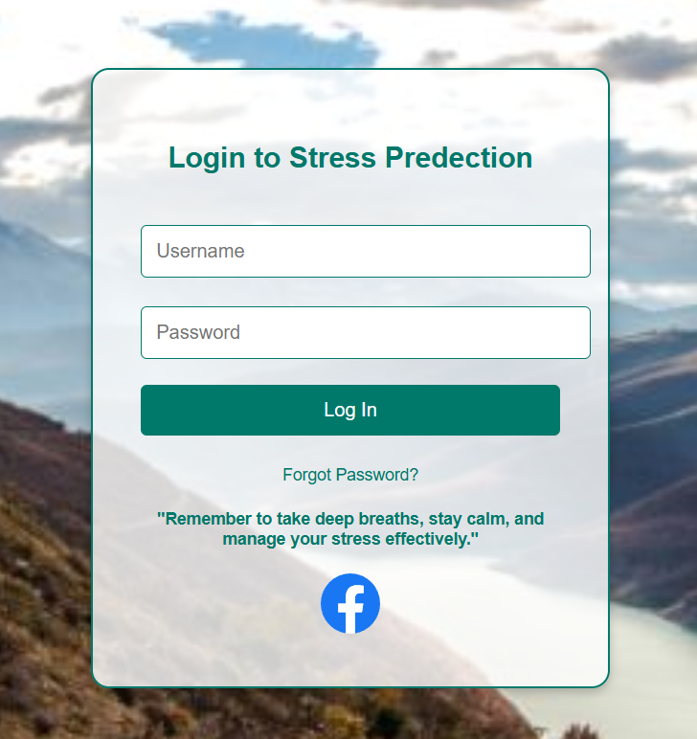
LOGIN PAGE
This login page is designed for the Stress Prediction platform, where users can securely log in to access their personalized stress detection and prediction insights
The page features a clean and calming background image, enhancing a sense of tranquility for users.

Slide 5
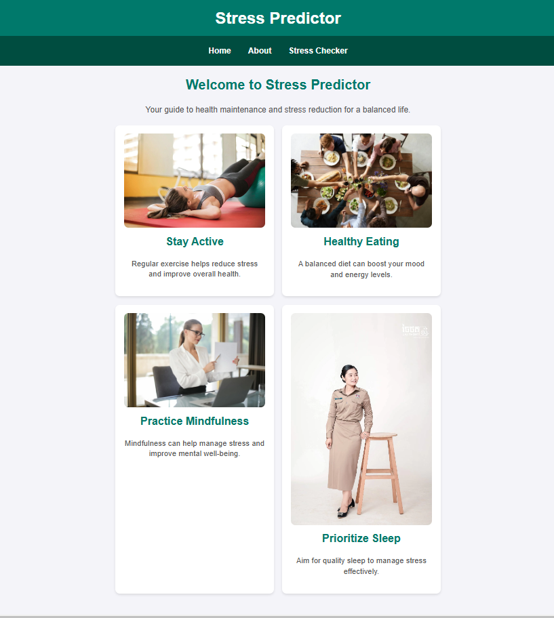
HOME PAGE
This webpage appears to be a home page for a stress-management website or application called "Stress Predictor."
It provides information and resources to help users maintain their health and reduce stress.
The page features sections on staying active, healthy eating, practicing mindfulness, and prioritizing sleep, with brief descriptions of how each can contribute to stress reduction and overall well-being

Slide 6
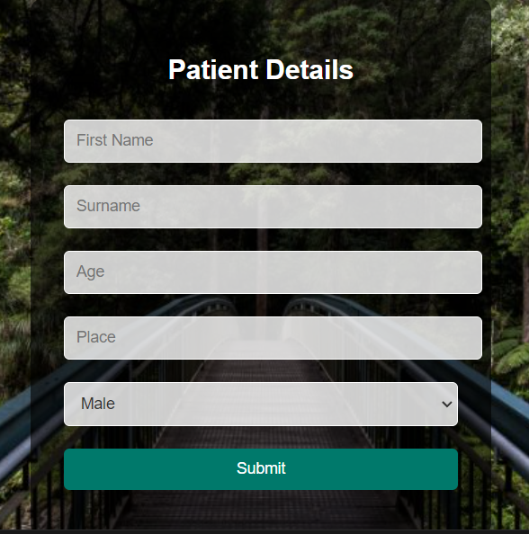

PATIENT DETAILS
A form that has to be filled with basic details of the admitting patient.

Slide 7

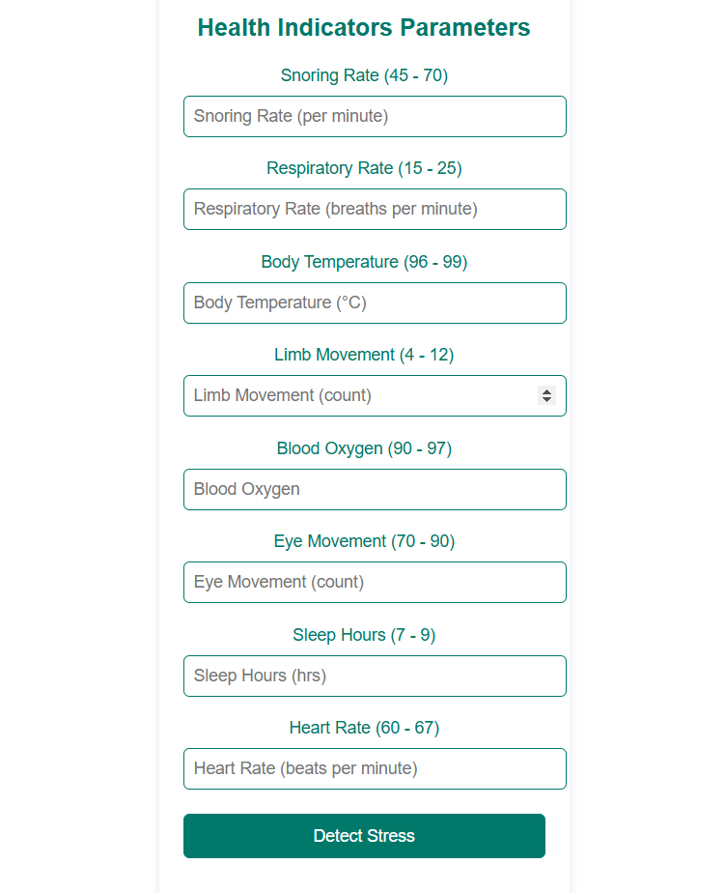
INPUT PARAMETERS
This webpage appears to be a home page for
a stress-management website or application called "Stress Predictor." It provides information and resources to help users maintain their health and reduce stress. The page features sections on staying active, healthy eating, practicing mindfulness, and prioritizing sleep, with brief descriptions of how each can contribute to stress reduction and overall well-being.

Slide 8

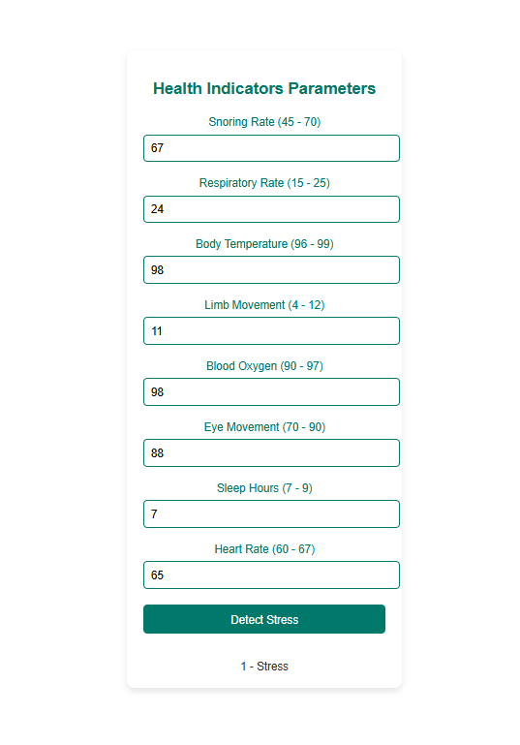
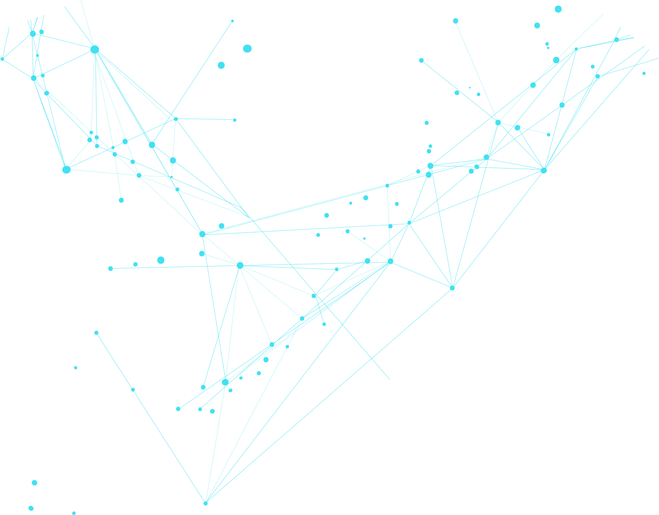
OUTPUT
On basis of the given input parameters it generates an output that the human is stressed indicating “1-stress”.

Slide 9

CONCLUSION
The ANN model effectively detects and predicts stress levels based on key physiological parameters. It shows promise in early stress detection, enabling timely interventions. Future research can further enhance its accuracy and capabilities.

Slide 10
THANK YOU
KISHORE BATCHALA
TEAM - 1

